Slide 1
Murach’s SQL Server 2022
Chapter 4
How to retrieve data from two or more tables

Slide 2
Objectives
Applied
Use the explicit syntax to code an inner join that returns data from a single table or multiple tables.
Code a union that combines data from a single table or multiple tables.
Knowledge
Explain when column names need to be qualified.
Describe the proper use of table aliases.
Describe the differences between an inner join, a left outer join, a right outer join, a full outer join, and a cross join.
Describe the use of the implicit syntax for coding inner joins.
Describe the use of the set operators: UNION, EXCEPT, and INTERSECT.

Slide 3
The explicit syntax for an inner join
SELECT select_list
FROM table_1
[INNER] JOIN table_2
ON join_condition_1
[[INNER] JOIN table_3
ON join_condition_2]...

Slide 4
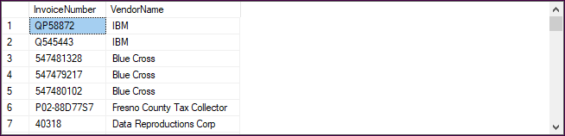
An inner join of the Vendors and Invoices tables
SELECT InvoiceNumber, VendorName
FROM Vendors
JOIN Invoices
ON Vendors.VendorID = Invoices.VendorID;
The result set (114 rows)

Slide 5
The syntax for an inner join that uses table aliases
SELECT select_list
FROM table_1 [AS] n1
[INNER] JOIN table_2 [AS] n2
ON n1.column_name operator n2.column_name
[[INNER] JOIN table_3 [AS] n3
ON n2.column_name operator n3.column_name]...

Slide 6

An inner join that doesn’t use table aliases
SELECT InvoiceNumber, VendorName, InvoiceDueDate,
InvoiceTotal - PaymentTotal - CreditTotal AS BalanceDue
FROM Vendors
JOIN Invoices
ON Vendors.VendorID = Invoices.VendorID
WHERE InvoiceTotal - PaymentTotal - CreditTotal > 0
ORDER BY InvoiceDueDate DESC;
The result set (11 rows)

Slide 7
An inner join that uses table aliases
SELECT InvoiceNumber, VendorName, InvoiceDueDate,
InvoiceTotal - PaymentTotal - CreditTotal AS BalanceDue
FROM Vendors v
JOIN Invoices i
ON v.VendorID = i.VendorID
WHERE InvoiceTotal - PaymentTotal - CreditTotal > 0
ORDER BY InvoiceDueDate DESC;
The same result set (11 rows)

Slide 8
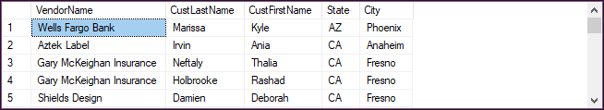
How to fully-qualify object names
The syntax of a fully-qualified object name
database.schema.object
A join with fully-qualified table names
SELECT VendorName, CustLastName, CustFirstName,
VendorState AS State, VendorCity AS City
FROM AP.dbo.Vendors v
JOIN ProductOrders.dbo.Customers c
ON v.VendorZipCode = c.CustZip
ORDER BY State, City;
The result set (37 rows)

Slide 9
The same join with partially-qualified table names
SELECT VendorName, CustLastName, CustFirstName,
VendorState AS State, VendorCity AS City
FROM Vendors v
JOIN ProductOrders..Customers c
ON v.VendorZipCode = c.CustZip
ORDER BY State, City;
The same result set (37 rows)

Slide 10
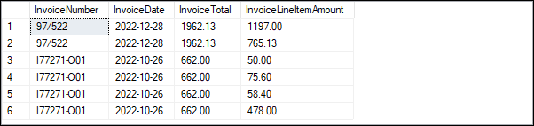
An inner join with two conditions
SELECT InvoiceNumber, InvoiceDate,
InvoiceTotal, InvoiceLineItemAmount
FROM Invoices i
JOIN InvoiceLineItems li
ON i.InvoiceID = li.InvoiceID AND
i.InvoiceTotal > li.InvoiceLineItemAmount
ORDER BY InvoiceNumber;
The result set

Slide 11
The same join with the second condition coded in a WHERE clause
SELECT InvoiceNumber, InvoiceDate,
InvoiceTotal, InvoiceLineItemAmount
FROM Invoices i
JOIN InvoiceLineItems li
ON i.InvoiceID = li.InvoiceID
WHERE i.InvoiceTotal > li.InvoiceLineItemAmount
ORDER BY InvoiceNumber;
The same result set

Slide 12
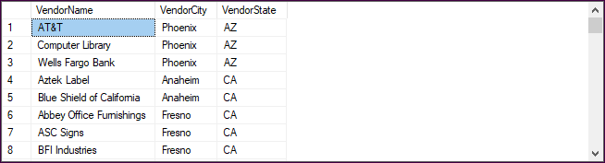
A self-join that returns vendors from cities in common with other vendors
SELECT DISTINCT v1.VendorName, v1.VendorCity,
v1.VendorState
FROM Vendors v1
JOIN Vendors v2
ON v1.VendorCity = v2.VendorCity AND
v1.VendorState = v2.VendorState AND
v1.VendorID <> v2.VendorID
ORDER BY v1.VendorState, v1.VendorCity;
The result set (84 rows)

Slide 13
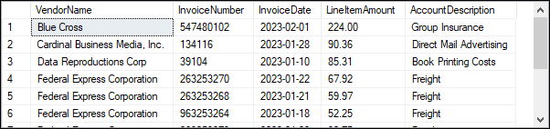
A join of four tables that uses the explicit syntax (11 rows)
SELECT VendorName, InvoiceNumber, InvoiceDate,
InvoiceLineItemAmount AS LineItemAmount,
AccountDescription
FROM Vendors v
JOIN Invoices i
ON v.VendorID = i.VendorID
JOIN InvoiceLineItems li
ON i.InvoiceID = li.InvoiceID
JOIN GLAccounts gla
ON li.AccountNo = gla.AccountNo
WHERE InvoiceTotal - PaymentTotal - CreditTotal > 0
ORDER BY VendorName, LineItemAmount DESC;

Slide 14
The implicit syntax for an inner join
SELECT select_list
FROM table_1, table_2 [, table_3]...
WHERE table_1.column_name operator table_2.column_name
[AND table_2.column_name operator table_3.column_name]...

Slide 15
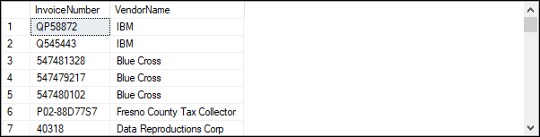
An implicit join of the Vendors and Invoices tables
SELECT InvoiceNumber, VendorName
FROM Vendors v, Invoices i
WHERE v.VendorID = i.VendorID;

Slide 16
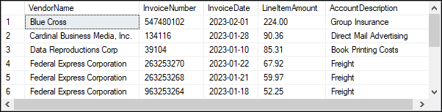
An implicit join of four tables
SELECT VendorName, InvoiceNumber, InvoiceDate,
InvoiceLineItemAmount AS LineItemAmount,
AccountDescription
FROM Vendors AS v, Invoices AS i, InvoiceLineItems AS li, GLAccounts AS gla
WHERE v.VendorID = i.VendorID
AND i.InvoiceID = li.InvoiceID
AND li.AccountNo = gla.AccountNo
AND InvoiceTotal - PaymentTotal - CreditTotal > 0
ORDER BY VendorName, LineItemAmount DESC;
The result set

Slide 17
The explicit syntax for an outer join
SELECT select_list
FROM table_1
{LEFT|RIGHT|FULL} [OUTER] JOIN table_2
ON join_condition_1
[{LEFT|RIGHT|FULL} [OUTER] JOIN table_3
ON join_condition_2]...
Three types of outer joins
A left outer join keeps unmatched rows from the first table
A right outer join keeps unmatched rows from the second table
A full outer join keeps unmatched rows from both tables

Slide 18
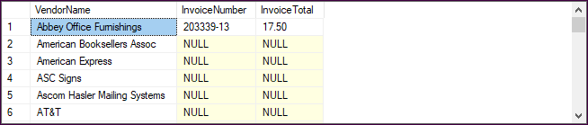
A SELECT statement that uses a left outer join (202 rows)
SELECT VendorName, InvoiceNumber, InvoiceTotal
FROM Vendors v
LEFT JOIN Invoices i
ON v.VendorID = i.VendorID
ORDER BY VendorName;

Slide 19
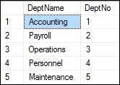
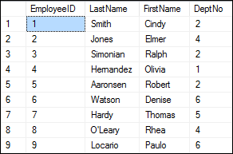
The Departments and Employees tables

Slide 20
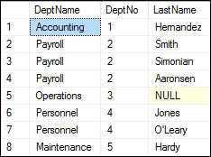
A left outer join
SELECT DeptName, d.DeptNo, LastName
FROM Departments d
LEFT JOIN Employees e
ON d.DeptNo = e.DeptNo;
The result set

Slide 21
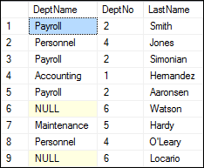
A right outer join
SELECT DeptName, e.DeptNo, LastName
FROM Departments d
RIGHT JOIN Employees e
ON d.DeptNo = e.DeptNo;

Slide 22
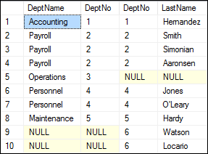
A full outer join
SELECT DeptName, d.DeptNo, e.DeptNo, LastName
FROM Departments d
FULL JOIN Employees e
ON d.DeptNo = e.DeptNo;

Slide 23
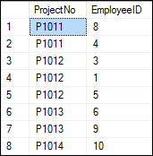
The Departments, Employees, and Projects tables

Slide 24
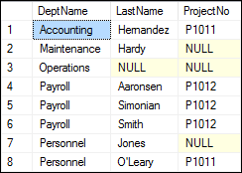
Join the three tables using left outer joins
SELECT DeptName, LastName, ProjectNo
FROM Departments d
LEFT JOIN Employees e
ON d.DeptNo = e.DeptNo
LEFT JOIN Projects p
ON e.EmployeeID = p.EmployeeID
ORDER BY DeptName, LastName, ProjectNo;

Slide 25
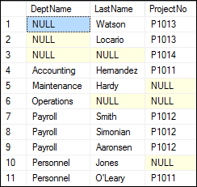
Join the three tables using full outer joins
SELECT DeptName, LastName, ProjectNo
FROM Departments d
FULL JOIN Employees e
ON d.DeptNo = e.DeptNo
FULL JOIN Projects p
ON e.EmployeeID = p.EmployeeID
ORDER BY DeptName;

Slide 26
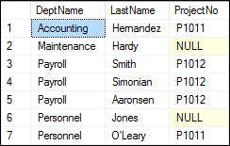
Combine an outer and an inner join
SELECT DeptName, LastName, ProjectNo
FROM Departments d
JOIN Employees e
ON d.DeptNo = e.DeptNo
LEFT JOIN Projects p
ON e.EmployeeID = p.EmployeeID
ORDER BY DeptName;

Slide 27
How to code cross joins
A cross join that uses the explicit syntax
SELECT d.DeptNo, DeptName, EmployeeID, LastName
FROM Departments d
CROSS JOIN Employees e
ORDER BY d.DeptNo;
A cross join that uses the implicit syntax
SELECT d.DeptNo, DeptName, EmployeeID, LastName
FROM Departments d, Employees e
ORDER BY d.DeptNo;

Slide 28
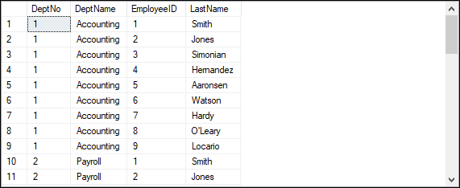
The result set created by the cross joins (45 rows)

Slide 29
The syntax for a union operation
SELECT_statement_1
UNION [ALL]
SELECT_statement_2
[UNION [ALL]
SELECT_statement_3]...
[ORDER BY order_by_list]
Rules for unions
Each result set must return the same number of columns.
The corresponding columns in each result set must have compatible data types.
The column names in the final result set are taken from the first SELECT clause.

Slide 30
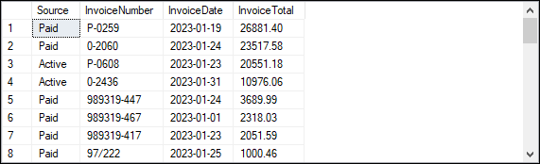
A union that combines data from two tables (35 rows)
SELECT 'Active' AS Source, InvoiceNumber,
InvoiceDate, InvoiceTotal
FROM ActiveInvoices
WHERE InvoiceDate >= '01/01/2023'
UNION
SELECT 'Paid' AS Source, InvoiceNumber,
InvoiceDate, InvoiceTotal
FROM PaidInvoices
WHERE InvoiceDate >= '01/01/2023'
ORDER BY InvoiceTotal DESC;

Slide 31
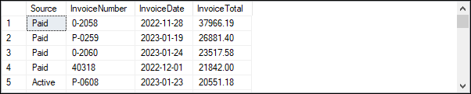
A union that combines data from the same table (114 rows)
SELECT 'Active' AS Source, InvoiceNumber,
InvoiceDate, InvoiceTotal
FROM Invoices
WHERE InvoiceTotal - PaymentTotal - CreditTotal > 0
UNION
SELECT 'Paid' AS Source, InvoiceNumber,
InvoiceDate, InvoiceTotal
FROM Invoices
WHERE InvoiceTotal - PaymentTotal - CreditTotal <= 0
ORDER BY InvoiceTotal DESC;

Slide 32
A union that combines payment data from the same joined tables (part 1)
SELECT InvoiceNumber, VendorName,
'33% Payment' AS PaymentType,
InvoiceTotal AS Total,
InvoiceTotal * 0.333 AS Payment
FROM Invoices i
JOIN Vendors v
ON i.VendorID = v.VendorID
WHERE InvoiceTotal > 10000
UNION
SELECT InvoiceNumber, VendorName,
'50% Payment' AS PaymentType,
InvoiceTotal AS Total,
InvoiceTotal * 0.5 AS Payment
FROM Invoices i
JOIN Vendors v
ON i.VendorID = v.VendorID
WHERE InvoiceTotal BETWEEN 500 AND 10000

Slide 33
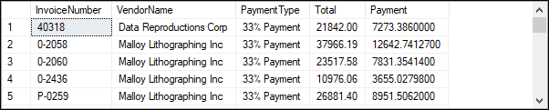
A union that combines payment data from the same joined tables (part 2)
UNION
SELECT InvoiceNumber, VendorName,
'Full amount' AS PaymentType,
InvoiceTotal AS Total, InvoiceTotal AS Payment
FROM Invoices i
JOIN Vendors v
ON i.VendorID = v.VendorID
WHERE InvoiceTotal < 500
ORDER BY PaymentType, VendorName, InvoiceNumber;
The result set (114 rows)

Slide 34
Syntax for the EXCEPT and INTERSECT operators
SELECT_statement_1
{EXCEPT|INTERSECT}
SELECT_statement_2
[ORDER BY order_by_list]

Slide 35
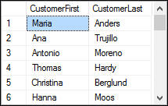
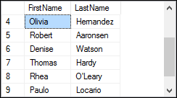
The Customers table (24 rows) and Employees table (9 rows)

Slide 36
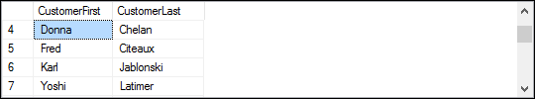
Exclude rows from the first query if they also occur in the second query
SELECT CustomerFirst, CustomerLast
FROM Customers
EXCEPT
SELECT FirstName, LastName
FROM Employees
ORDER BY CustomerLast;

Slide 37
Only include rows that occur in both queries (1 row)
SELECT CustomerFirst, CustomerLast
FROM Customers
INTERSECT
SELECT FirstName, LastName
FROM Employees;

